Slide 1
Market Basket Analysis
Huma Asmi
Kusay Rukieh
Nadir Syed

Slide 2
Who we Are
Huma Asmi
  7 Years in Business Intelligence
  Bsc – Information Technology
Kusay Rukieh
  20 Years in IT (Information Technology)
  Network Engineering
Nadir Syed
  14 years financial industry
  Software Developer

Slide 3
Market Basket Analysis (MBA)
Business problem
To help a boutique (clothing retailer) with Market Basket Analysis to increase sales in-store and online.
What is Market Basket Analysis?
MBA is a technique used to study customer purchase behaviors. It is used to determine what items are frequently bought together or placed in the same basket by customers.
  Electronic point-of-sale systems play a vital role in keeping the record of sales and make it easier to process and collect the required data.

Slide 4
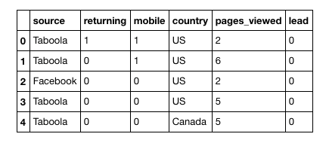
Questions for Business
Define single order/basket? All items bought same day/week etc?
What is the source of advertising the business (Taboola, Facebook, etc)
What is the sales regions ( USA / International)?
When was the item bought (some items sell better at certain times)?
What device is used for the purchase?

Slide 5
Communication
We will be using multiple modes of communication as and when required. However mostly we will use
  WhatsApp for notifications
  Slack for project documents/ideas etc.

Slide 6
Code Book
Target Variable : None
Target Variable :None
Deliverable: Group
Cluster Analysis

